Slide 1


Slide 2


Are you Adventurous ?

Slide 3

Problem???

Slide 4
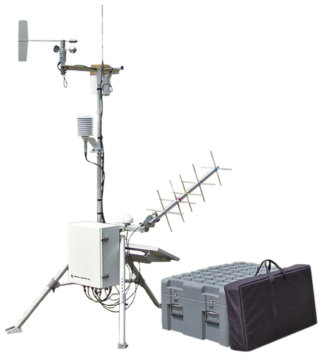


Intended Solution?
Portable Weather Stations
Not Portable
Consumes more power
Mobile Apps (AccuWeather, Google Now)
Unreliable
Provincial Based
Needs Cell Reception

Slide 5
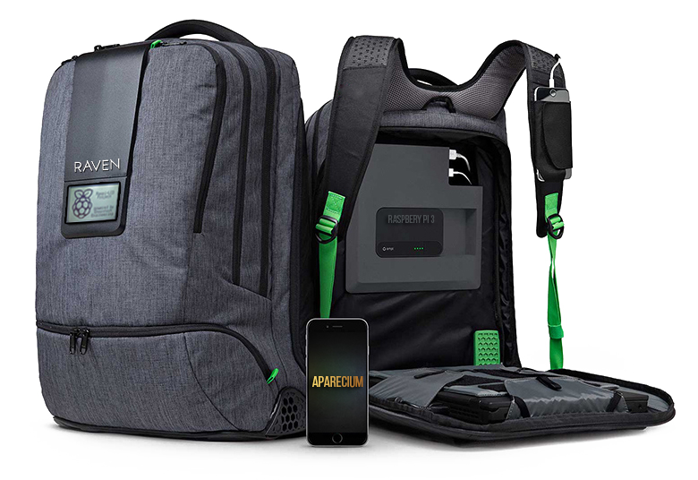
PROTOTYPE (Design)

Slide 6
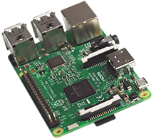
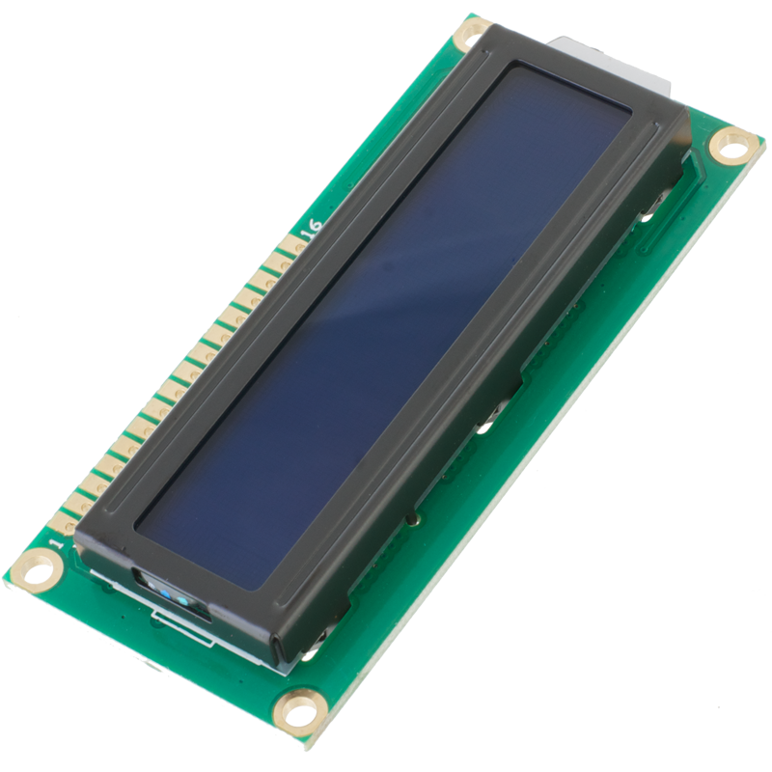
Hardware
Backpack.
Raspberry Pi 3
Power Bank
BMP O85 Sensor - Barometric Pressure/Temperature/Altitude
DHT 11 – Humidity Sensor
MQ7 – Carbon Monoxide Sensor
MQ-135 – Methane, LPG, Propane Sensor
LDR Module – Photoresistor
Rain Drop Sensor
Ultrasonic Sensor Module
Neo-6M GPS Module
Microphone (Phase 2)
LCD Display Module
Speaker (Phase 2)

Slide 7
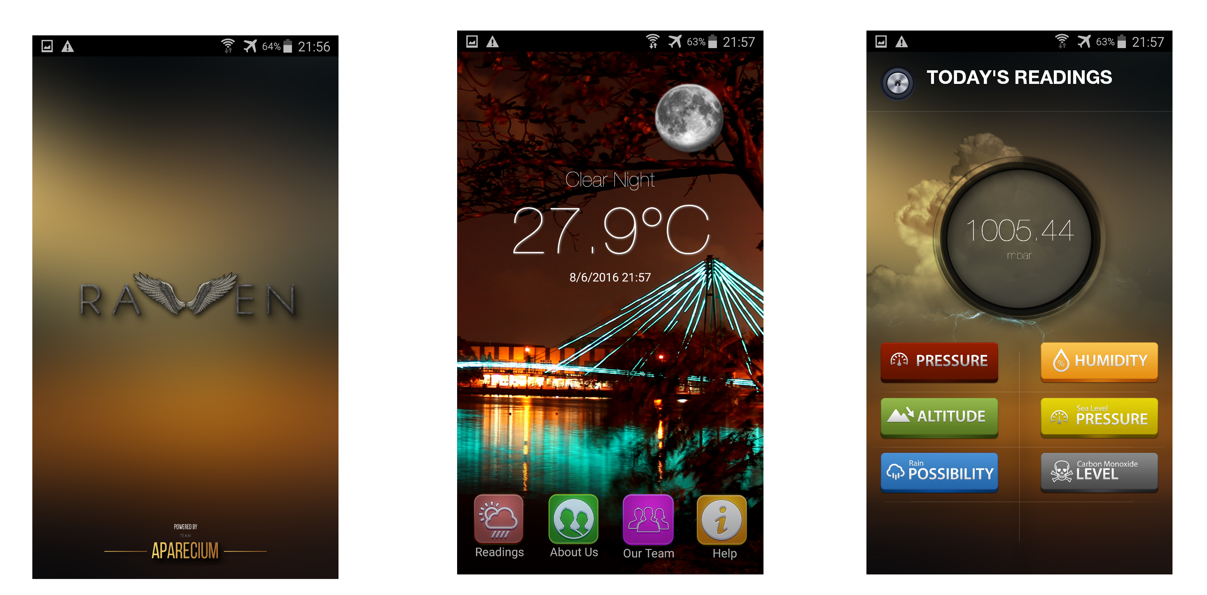
Mobile App

Slide 8
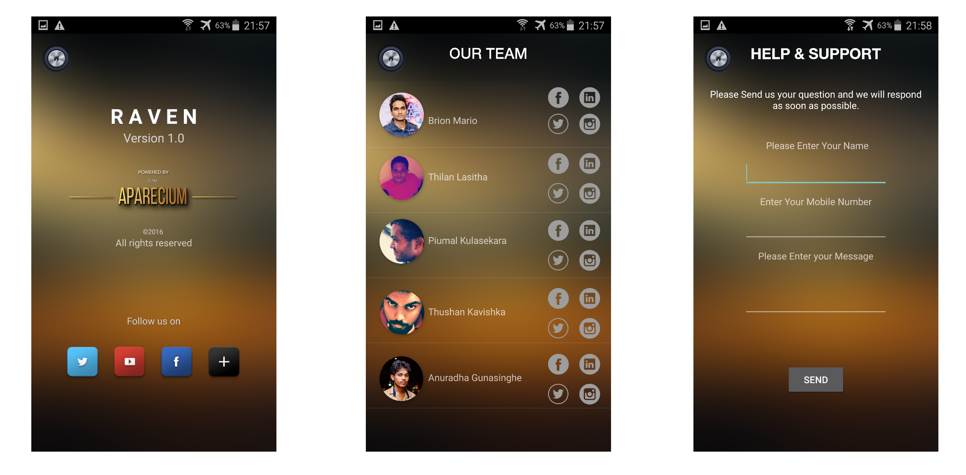
Mobile App

Slide 9
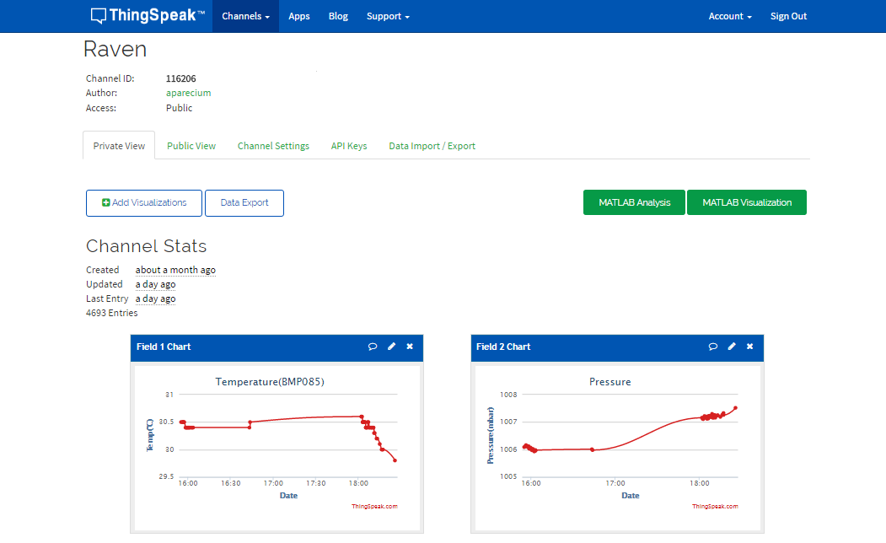
CLOUD Thingspeak
https://thingspeak.com/channels/116206

Slide 10
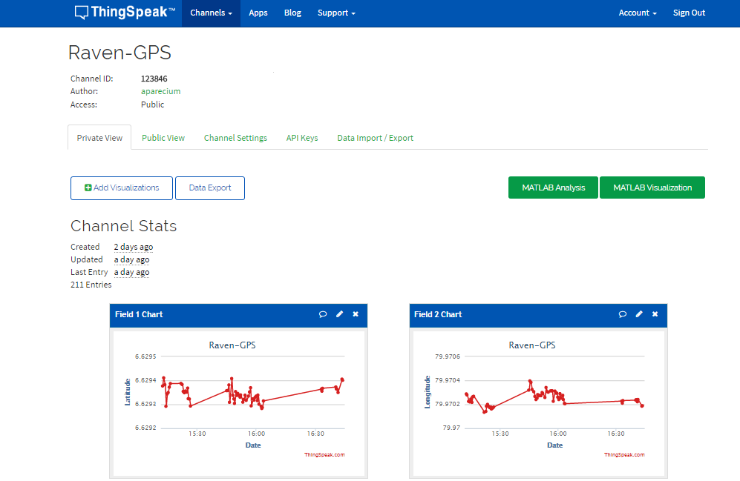
CLOUD Thingspeak
https://thingspeak.com/channels/123846

Slide 11
Why is this Product essential?
Provides Accurate weather details
Easy to use
User friendly App UI
Real-Time Readings
Reaction Tweets Through the Cloud
Same as your everyday backpack

Slide 12



Phase 2
Voice Recognition Functionality
Add a Radiation Measuring unit
Add Voice Notifications
Expand Platform Compatibility
Add a Motion Detector

Slide 13

Q&A

Slide 14

Our Team

Slide 15
Thanks !

